Slide 1
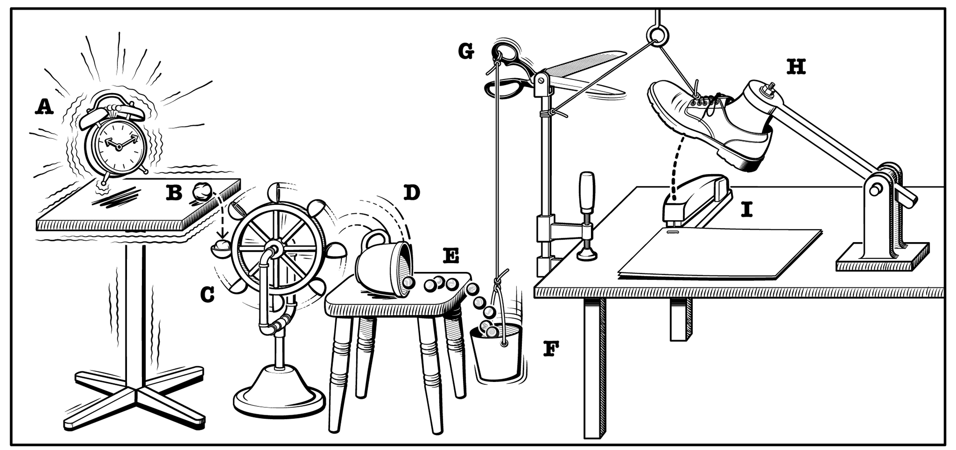
Framing & Scope
Build a creative chain reaction using random materials & Raspberry Pi
Intended outcome:
A large chain reaction consisting of smaller chain reactions
Learning to work with a Raspberry Pi
Problem-solving through hands-on experience
Groups of 4 students
Every students brings a random object, other groups should incorporate that object
The Raspberry Pi’s should communicate with each other to link every smaller chain reaction
Group 14

Slide 2
Materials
Toolbox
Seed
Electronic Raspberry Pi kit
Raspberry Pi
Sensors
Wires
Actuators
LEDs
Etc.
General material supply
Cardboard
Lego
Iron wire
Rope
Scrap materials
Etc.
Random household items (brought by students)
Football
Spoon
PET bottle
Toilet paper
Etc.
Group 14

Slide 3
Scaffolding & Facilitation
Required prior knowledge
Short instruction
Location & Facilitation
Raspberry Pi
Coding
Connecting Raspberry Pi’s to each other
Use of sensors
Goal of the session
Day layout
(the use of) Materials & random materials
Encouraging final words
SmartXP
Table layout
Facilitator:
Providing support
Group 14

Slide 4
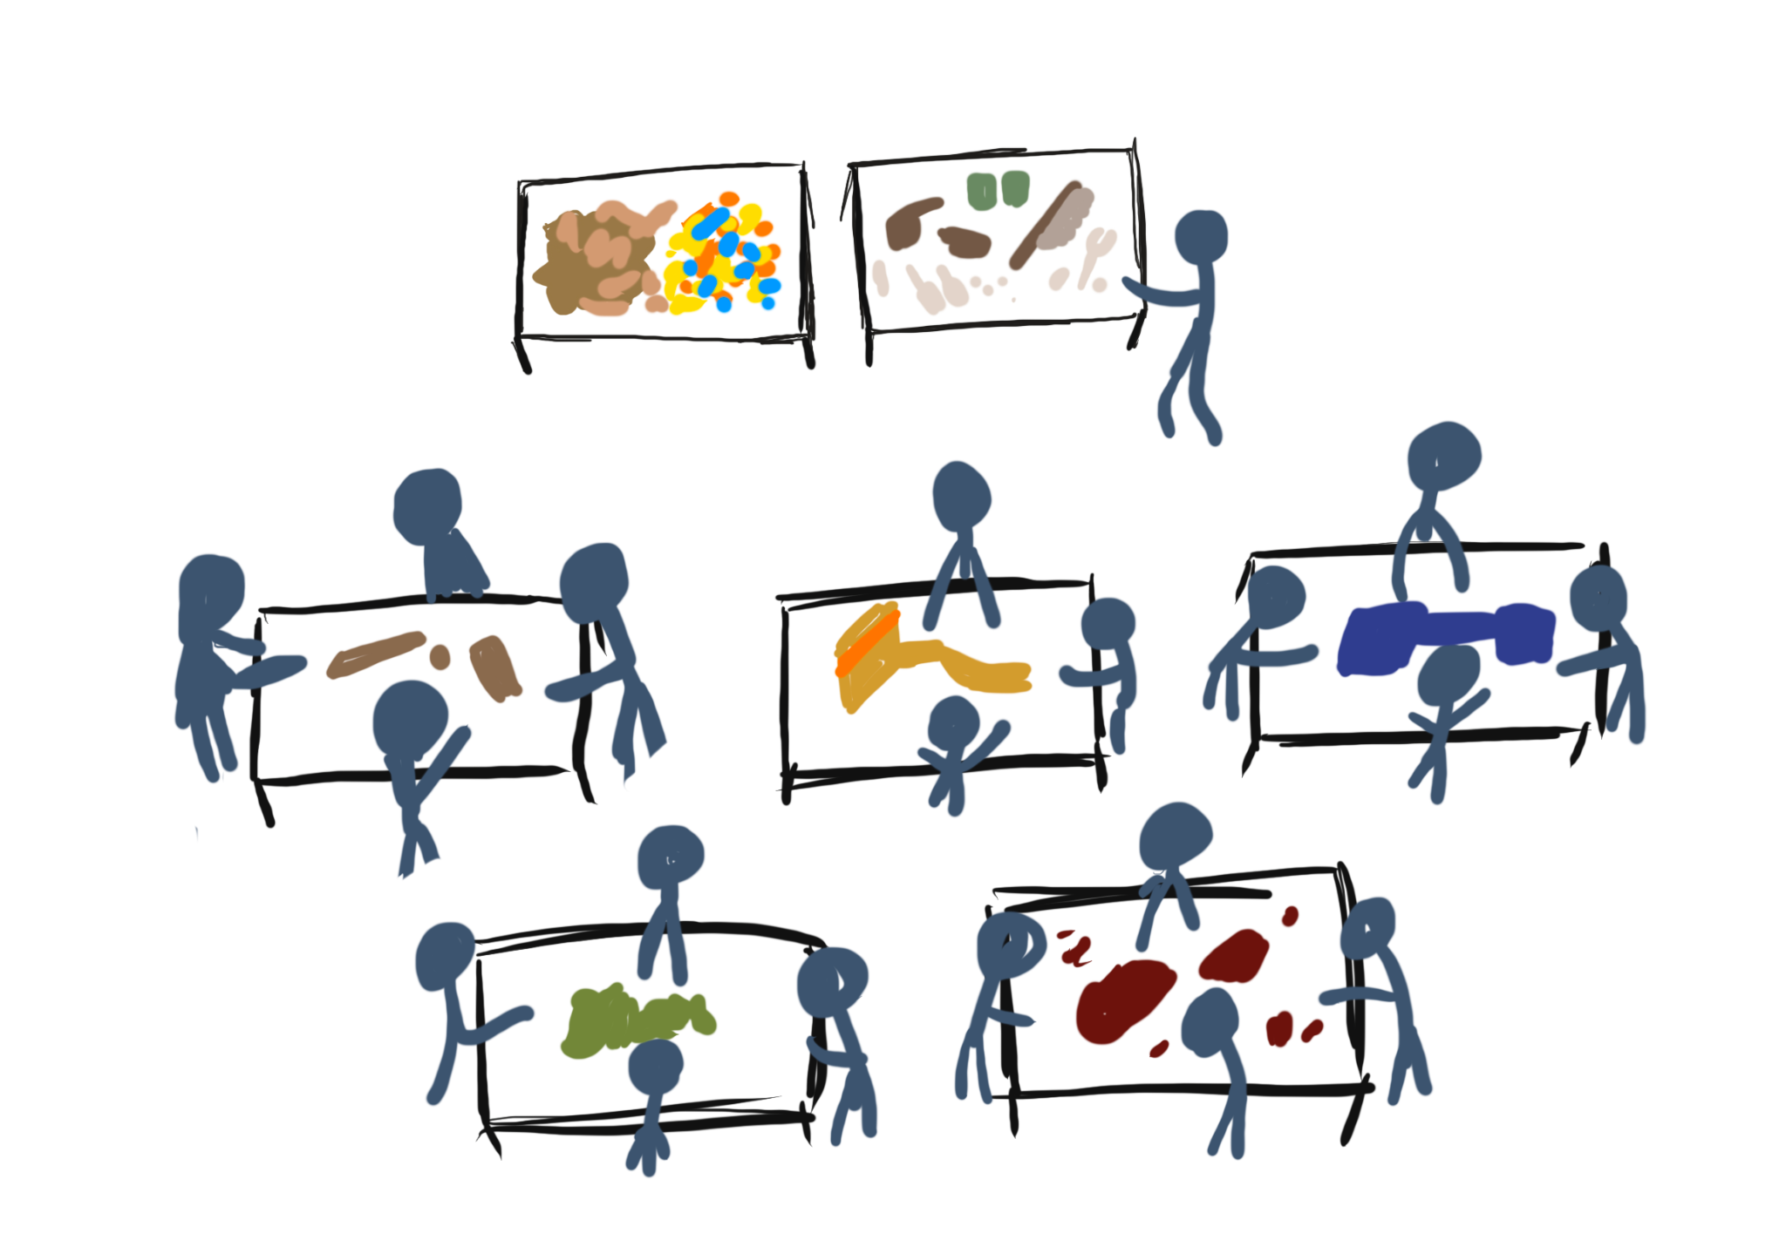
Process
Introduction with explanation
Making groups
Assigning random objects
Giving toolboxes to groups
Start building
Connecting chains
Seeing result / reflecting
Clean-up
Group 14

